Slide 1


Audio Codeword Decryption
Rensselaer Polytechnic Institute

Slide 2

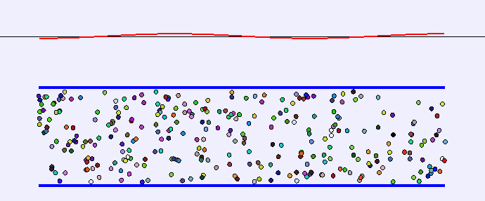
Soundwaves!
Soundwaves travel through air longitudinally.
Lower frequency
= Deeper pitch sound
Larger frequency
= Higher pitch sound

Slide 3
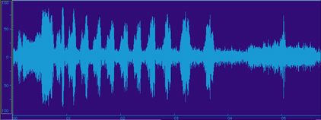

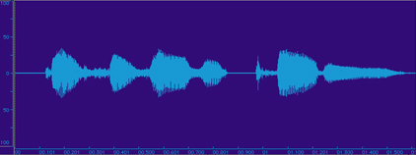
Recorded Audio
Sound is often recorded as an electronic signal.
Filtering of audio signal is useful for many applications!

Slide 4
Open ‘gameTutorialRH’ in OCTAVE

Slide 5
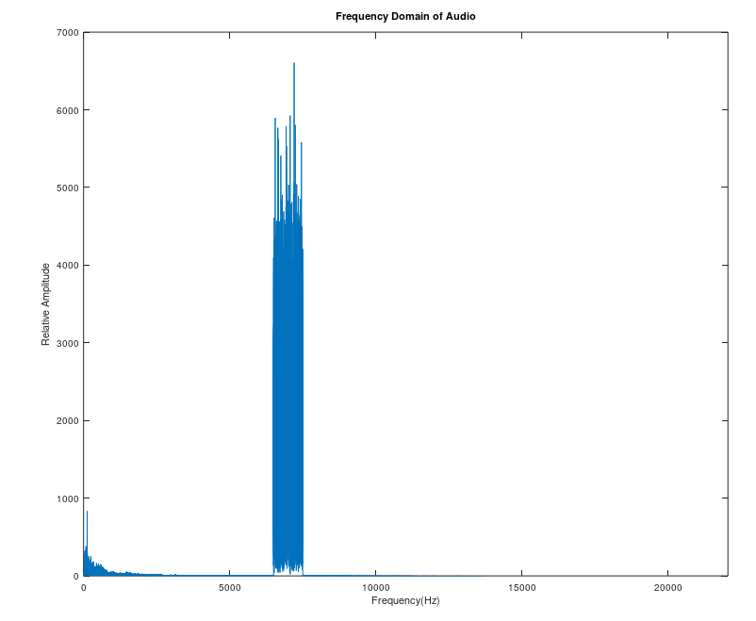
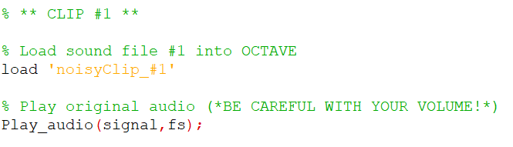
Encrypted Audio Files

Slide 6
What filter would clean the signal?
Highpass?
Lowpass?
Bandstop?
Bandpass?

Slide 7
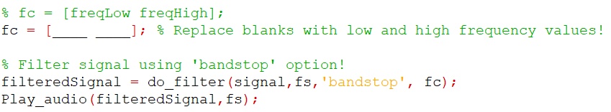
Choose the range!

Slide 8
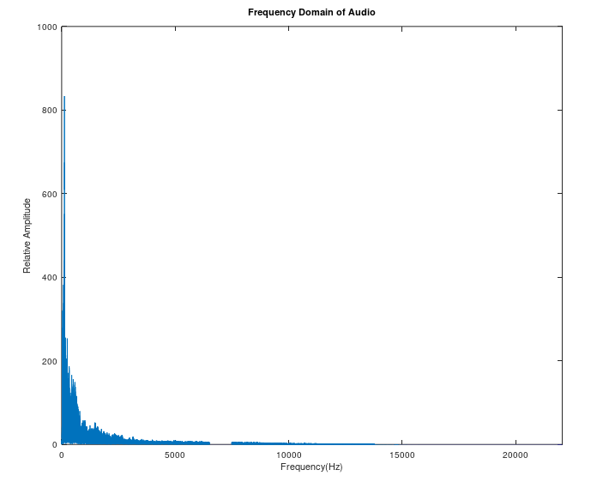
*Who was the person speaking?

Slide 9
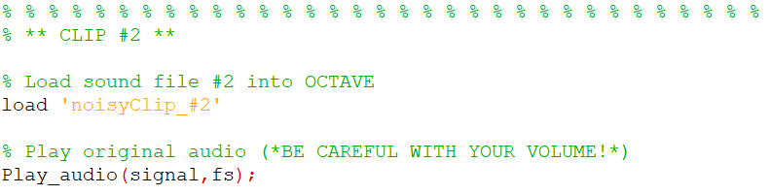
Next Clip!
*What is different about the frequency spectrum of this graph?

Slide 10
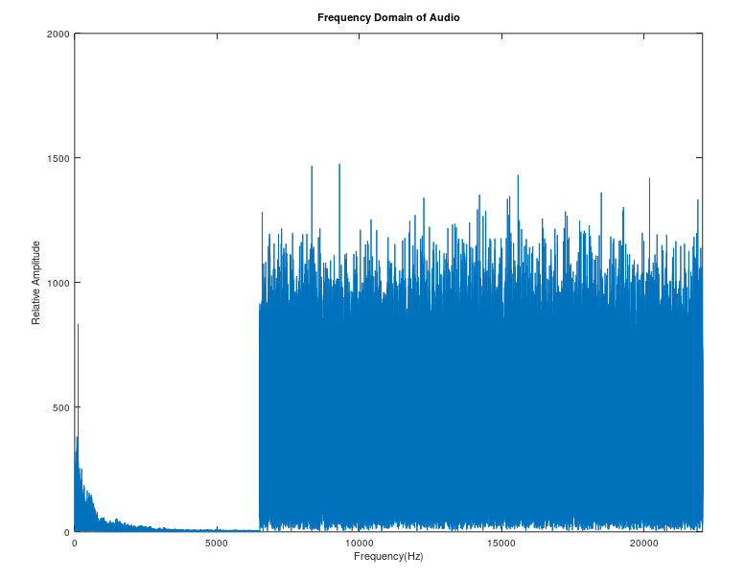
What filter would clean the signal?
Highpass?
Lowpass?
Bandstop?
Bandpass?

Slide 11
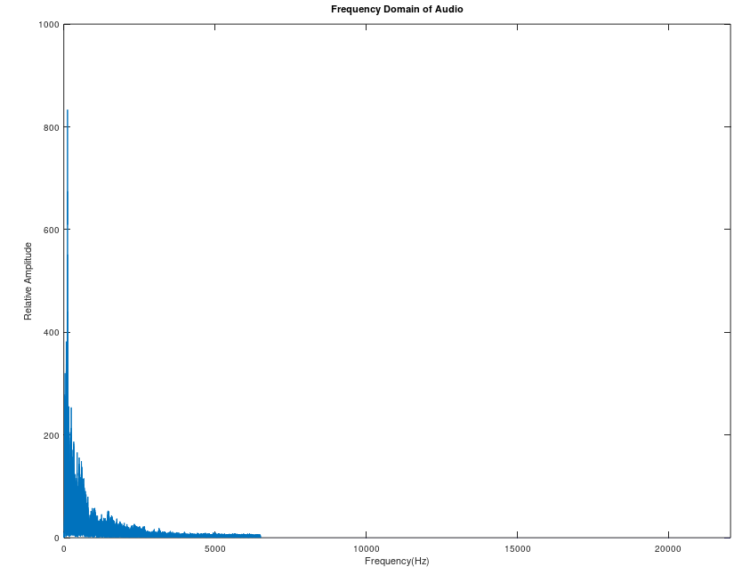
*Why would the previous bandstop filter NOT have worked for this audio clip?

Slide 12
Message Decryption through Audio Filtering

Slide 13
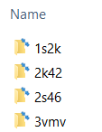
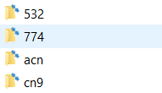


Objective
Each group will clean audio files containing a random message of seven letters and numbers.
Example: ‘x87v774’
These seven characters are paired with a folder inside of the folder ‘mainDirectory/’
First, find the folder of first four characters ‘x87v/’
Next locate the subfolder given by last three characters ‘774/’
$$⋯$$

Slide 14
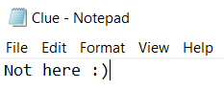
(continued…)
Inside this folder, there will be two files!
‘clue.mat’
‘Clue.txt’
If the message decoding was correct, you will be able to open the ‘Clue.txt’ file and get the first part of the message.
If the message decoding was incorrect, you will receive a message like this…
The ‘clue.mat’ file inside contains the next sound file to decode. Load this file and use what you’ve learned to choose the appropriate filter to figure out where to get your next clue!
The end message has five words, so once your group figure out the message write it down and show it to an EA.

Slide 15
Open ‘decoderFile.m’ in the ‘audioDecoder/’ folder and load ‘clue#1_START.mat’ to get started!

Slide 16
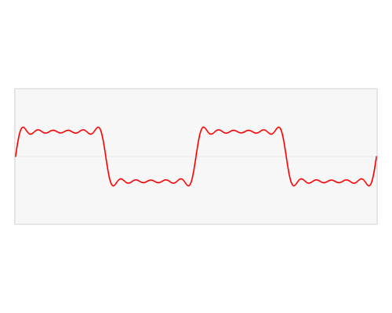
Awesome Fourier GIF

